Slide 1
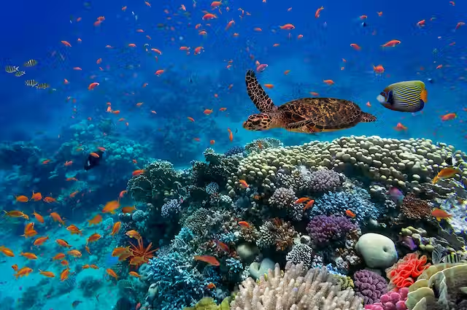
Measuring Biodiversity
Kim Thompson
January 16, 2024

Slide 2
Learning Objectives
At the end of this week you will have:
Learned how to describe biodiversity
Learned how to calculate and interpret these metrics
Learned how sampling affects the metrics you calculate
Applied this knowledge to the modeled and to real-world data
Weekday | Topic | Teacher
Monday | Comparing & Quantifying diversity | Roel van Klink
Tuesday | Measuring biodiversity | Kim Thompson
Wednesday morning | Sampling biodiversity | Alban Sagouis
afternoon | Project start | Alban, Kim, & Roel
Thursday | Project work | Helpdesk: 11:00 & 15:00h
Friday morning | Project work | Helpdesk if needed
afternoon | Presentations | 15:00 – 16:00h

Slide 3

What is biodiversity?
UN definition:
Biodiversity is the variety of life on Earth, it includes all organisms, species, and populations; the genetic variation among these; and their complex assemblages of communities and ecosystems.

Slide 4
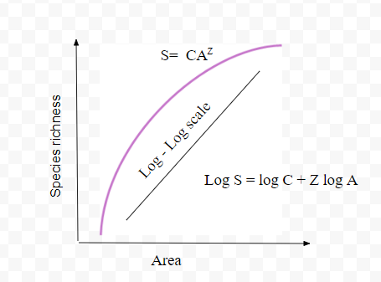
Measuring Biodiversity
Notes:
From the lecture yesterday you know the importance of scale, and so a critical addition when we talk about measuring biodiversity is that we’re focusing on a particular area.
You saw some examples of species area curves yesterday, highlighting that as more area is sampled, more species will be detected. This has important implications for how we measure biodiversity.

Slide 5
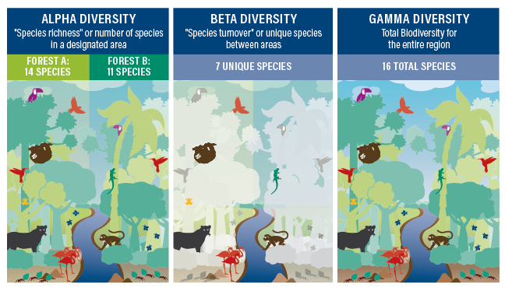
Measuring Biodiversity
Notes:
Because of this, we think about biodiversity on different scales. The alpha scale can be thought of as a more local scale, gamma regional, and beta is where they overlap.
We’ll focus on alpha scale first.

Slide 6
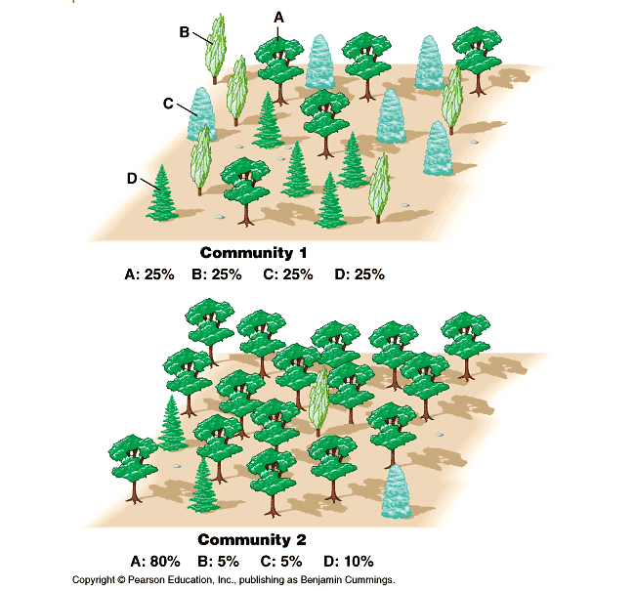
Species Richness (S)
Number of different species
Extremely common due to its simplicity
Most sensitive to differences in sampling effort since it weights all species equally independent of their relative abundances.
Rare species count equally to common species even though they are more likely to be undetected.
Notes:
Species richness does not take into account how many individuals of each species there are. It’s possible for one species to completely dominate an area, but they both have the same richness.
To account for this we can calculate evenness.

Slide 7
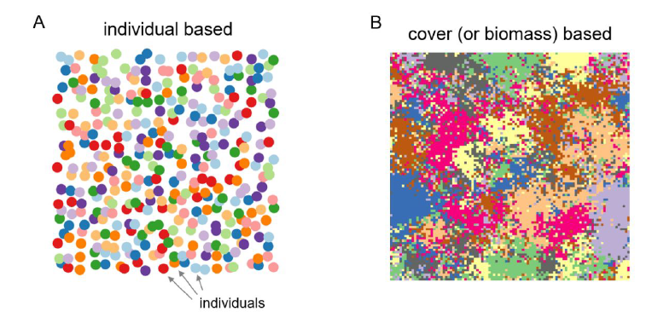
Abundance (N and n)
Number of individuals (or cover/biomass)
Of each species → n
Of all species → N
Individuals vs. cover/biomass
Notes:
# of individuals used when individuals are easily recognized (most animals, trees)
Cover/biomass used for organisms where boundaries between individuals aren’t clear (mostly plants)
In most cases, the
dominance (“biomass-based”) values can be treated in the same way as the numbers of individuals and can be
imagined as “bits of biomass” randomly collected within a fixed area of the community.

Slide 8
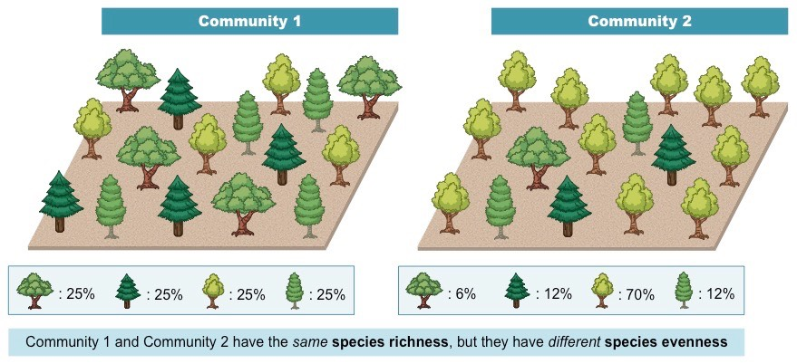
Species evenness / Relative species abundance
A measure of the number of individuals of a species in relation to the total number of species in an area.
Essentially a measure of distribution – are the number of individuals evenly spread?
High evenness values indicate similar numbers of individuals of each species.
Notes:
Two communities, same species richness (4) but different relative abundances.
We will talk more about how to measure evenness in a few minutes, but for now we need to just introduce the concept to be able to understand the next couple metrics we’ll discuss.

Slide 9
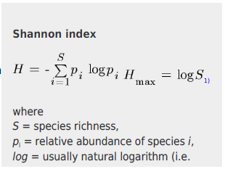
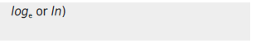
Shannon-Wiener Diversity Index (H)
Also called Shannon entropy
Considers both species richness and evenness
Represents the uncertainty with which we can predict which species will be randomly selected when drawing one individual from the community
0 → total certainty
If the community contains only 1 species, the uncertainty is zero since we are sure that that randomly chosen individual will come from that species.
The more species a community contains, the higher the uncertainty
However if a community has many species but is dominated by one or two, uncertainty will not be as high since we have a high probability that an individual randomly selected will be from the dominant species.

Slide 10
Shannon-Wiener Diversity Index
Values can range from 0 to log(S) where log(S) indicates total uncertainty
The maximum value of H, log(S) occurs at a situation where the community is perfectly even.
Values from real world data often range between 1.5 and 3.5 (units can be considered as ‘bits of information’)
Shannon index increases with increased richness and increased evenness, but it puts more weight on richness than evenness.

Slide 11
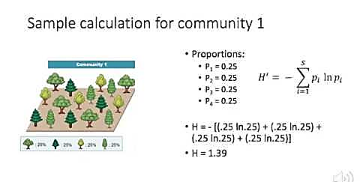
Shannon-Wiener Diversity Index

Slide 12
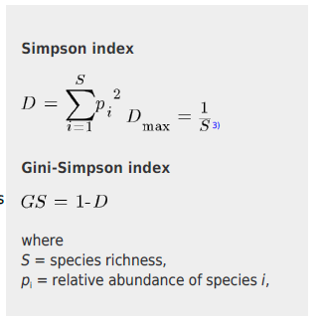
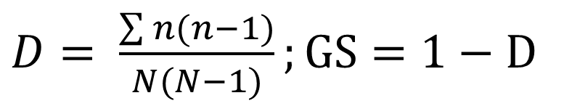
(Gini-)Simpson index
Considers both species richness and evenness
Compared to Shannon though, it is more influenced by evenness than richness.
It represents the probability that two randomly selected individuals will be of the different species
Ranges from 0 to 1
This probability decreases with increasing species richness of the communities, so the Simpson index also decreases with richness which is not very intuitive.
For this reason, it is more meaningful to use the Gini-Simpson index which is simply 1-Simpson, and which increases with the increasing richness of the community.
$D= \frac{\sum{n(n−1)}}{N(N−1)};GS=1−D$
n = the total number of individuals of a particular species
N = the total number of individuals of all species

Slide 13
(Gini-)Simpson index
As S ↑, GS ↑
What does this mean?
With more species, the probability that two randomly selected individuals would be from the same species would be low
Of course, this also depends on evenness
For Gini-Simpson, since it’s 1 – D, we can interpret values as the probability that 2 randomly selected individuals are from different species
If GS = 0.71, what does that mean?
What’s the probability that 2 randomly selected individuals are from the same species?
Note that Gini-Simpson is also identical to Hurlbert’s probability of Interspecific encounter (PIE).
$D= \frac{\sum{n(n−1)}}{N(N−1)};GS=1−D$
n = the total number of individuals of a particular species
N = the total number of individuals of all species
Notes:
0.71 chance that 2 randomly selected individuals are from different species

Slide 14
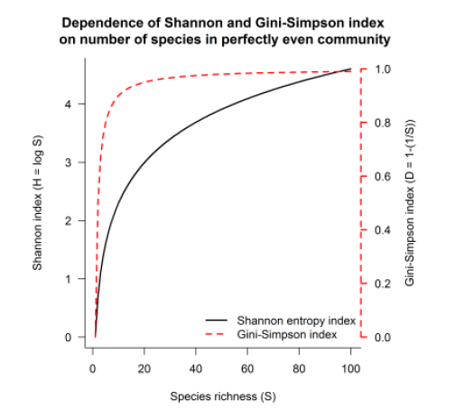
Comparing richness, Shannon, and Simpson
Notes:
In the case of perfectly even communities, the Shannon and Gini-Simpson index (when projected
against the species richness of the same community) increases non-linearly with the number of species in the
community; the Gini-Simpson index increases faster than Shannon entropy. This relationship also illustrates that
the Gini-Simpson index changes very fast in low species richness values (0.5 for S = 2, 0.67 for S = 3, 0.75 for S
= 4, ... 0.9 for S = 10), and with richness over 10, it changes much slower (0.95 for S = 20 and 0.99 for S =
100).
Because they weight richness and evenness differently.

Slide 15
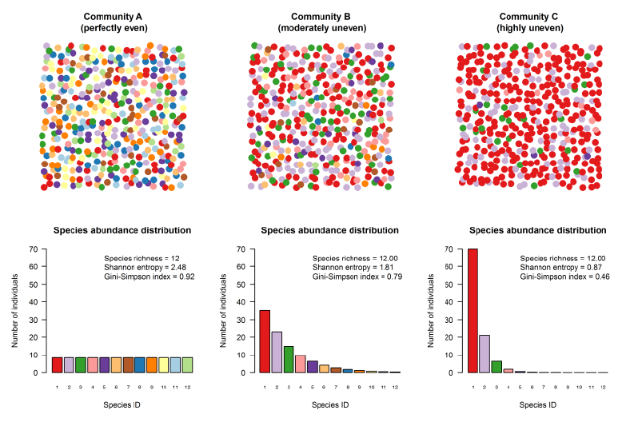
Species evenness / Relative species abundance
Notes:
Below is an example of three communities with the same species richness (12 species) but different evenness,
from perfectly even (A), moderately uneven (B) and highly uneven (C). In the following examples, we will focus
on individual-based species abundances, while acknowledging that the same formulas also work for biomassbased
species dominance.
The upper row represents a snapshot of each community, where each circle is an individual, and each colour is
a different species. The bar plots in the lower row represent the shape of species abundance distribution after
100 individuals were randomly taken from each community; the colour of each bar corresponds with the colour
of species, and the height of the bar represents the abundance of species, i.e. how many individuals within the
selected set belong to that species; species are ordered from the highest to lowest abundance. The legend
within each barplot shows relevant values of diversity indices (species richness, Shannon index and Gini-
Simpson index).
We see that the Shannon values decrease as evenness decreases, indicating that for Community C for example, we are more certain (i.e., the value is closer to 0) that an individual drawn at random would be from the red species.
We see that Gini-Simpson values also decrease as evenness decreases when richness remains constant. So for community A, there is a high probability 0.92 that two indiviuduals randomly selected would be from different species, while for community C, we have only a 0.46 probability that they’d be from different species. This makes sense since comm C is dominated by the red species.

Slide 16
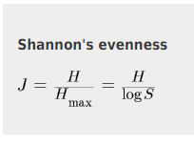
Shannon’s Evenness
Shannon’s evenness, also called Pielou’s evenness or Pielou’s J
Ratio of the Shannon index calculated from
the real community (with S species and p₁, p₂, p₃, …, pi relative species abundances)
and the maximum Shannon index for the community having the same richness Hmax (i.e., with S species all having p₁ = p₂ = p_{i} = 1/S).
The value is 1 when all species have the same relative abundance
Values decrease with increasing differences in species relative abundances in the community.

Slide 17
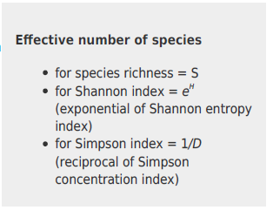
Effective Number of Species (ENS)
Ecologists consistently trying to improve the metrics.
In 2002, Lou Jost argued that to call either Shannon and Simpson (or Gini-Simpson) indices as diversity is misleading since diversity should be measured in intuitive units of species.
Shannon has the units of ‘bits of information’ while Simpson has probability.
We can overcome this problem with the effective number of species (ENS).
ENS = a number of species in an equivalent community (i.e., the one which has the same value of diversity index as the community in question) composed of equally-abundant species.
In the case of a perfectly even community, ENS = species richness, while for uneven communities, ENS is always smaller than species richness.
Notes:
There are many things that confound our measurements of biodiversity – you learned yesterday about the ways that sampling effort, heterogeneity, scale, and metacommunity processes can impact biodiversity measurements.
Because of this ecologists have consistently tried to improve the metrics.

Slide 18
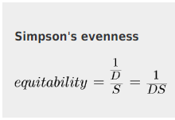
Simpson’s Evenness
Also called equitability
Calculated from Simpson’s effective number of species divided by the observed number of species.
The effective number of species (ENS) is the number of equally abundance species which would need to be in a community so that it has the same Simpson’s index as the one really calculated.
In the case of Simpson’s D, the effective number of species is simply 1/D

Slide 19
Individual Practice
To get more comfortable with the metrics we have discussed so far, please complete the following worksheets found in the Github:
Richness, Abundance, Shannon, Evenness.docx
Simpson’s diversity index.docx

Slide 20
Hill Numbers
A way to tie together richness, Shannon, and Simpson
Hill Numbers are a mathematically unified family of diversity indices
Shannon and Simpson both represent measures of entropy, or the measure of disorder in a system
more disorder → more diversity
There is a general equation for entropy from which Shannon and Simpson are derived
The equation has a parameter ‘q’ that defines how sensitive the output value is to rare species
Low values of q favor rare species, high values of q favor abundance species
When q = 0, diversity = S because rare species are treated equally to abundant ones
When q = 1, diversity = Shannon
When q = 2, diversity = Simpson

Slide 21
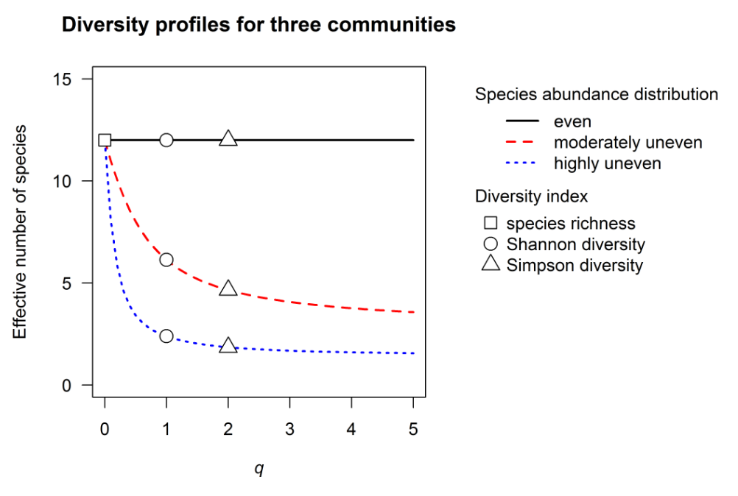
Hill Numbers
When q> 2, the interpretation becomes less straightforward
These diversity values are generally considered to emphasize the importance of dominant species more than rare ones
So for q>2, the diversity values are more sensitive to the abundance of the most common species
Higher order Hill numbers (q>2) are less commonly used in ecology because their interpretation is very complex

Slide 22
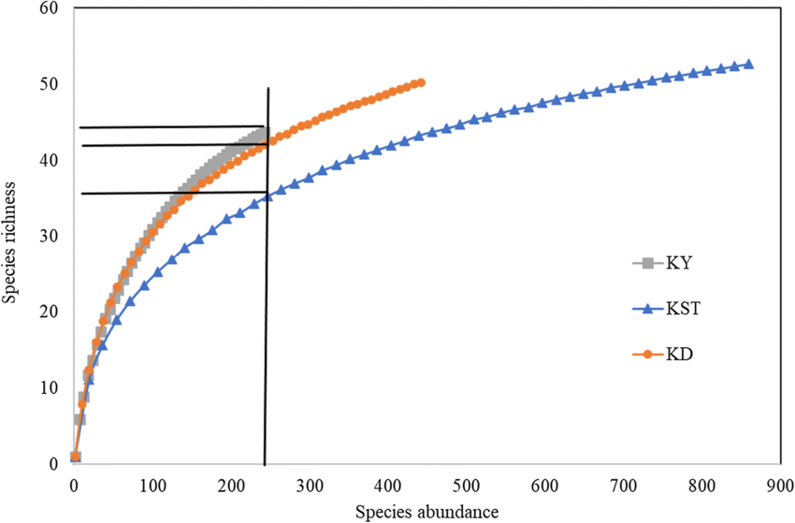
Rarefied Richness
Rarefaction is a technique to assess expected species richness
Problem: the larger the number of individuals sampled, the more species that will be found.
Solution: Create rarefaction curves (Abundance vs. Richness) and then extract species richness for a common number of individuals
How is this done?
Randomly resample of the pool of N individuals (total individuals observed in the community) multiple times
Then plot the average number of species found in each sample
Rarefaction curves generally grow rapidly at first, as the most common species are found, but plateau as only the rarest species remain to be sampled.
Notes:
Use vegan tutorial

Slide 23
Beta Diversity
beta diversity: the change in species composition from place to place, or along environmental gradients (turnover)
gamma diversity: the diversity of a region or landscape due to either or both α and β.
alpha diversity: the diversity of a site
Notes:
So far we’ve been focused on the alpha scale, but now we’ll turn our attention to beta diversity because it’s a very important, yet complicated bridge between what we measure at the site-level, or the local-level, and what is going on at a regional or landscape level.

Slide 24
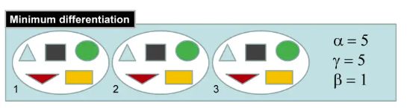
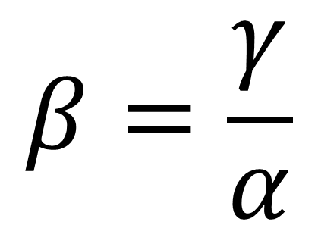
Whittaker’s Beta Diversity
Also called multiplicative beta diversity
Whittaker (1960) defined beta diversity as “the extent of change in community composition, or degree of community differentiation, in relation to a complex gradient of environment, or a pattern of environments.”
When species richness at each site (alpha) equals the regional species richness (gamma), beta diversity is 1.
$$β=\frac{γ}{α}$$

Slide 25
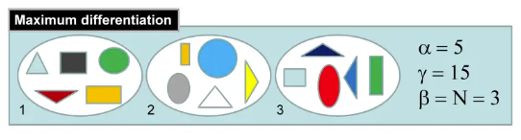
Whittaker’s Beta Diversity
When local richness is completely different, but with each site containing the same number of species, gamma diversity equals the species richness value at any one site multiplied by the total number of sites.
$$β=\frac{γ}{α}$$
Values of Whittaker’s beta range from 1 (all sites are the same) to the number of sites in our sample.
Since the value is dependent on the number of sites in the sample we standardize beta --- this is where (dis)simililarity indices come in!

Slide 26
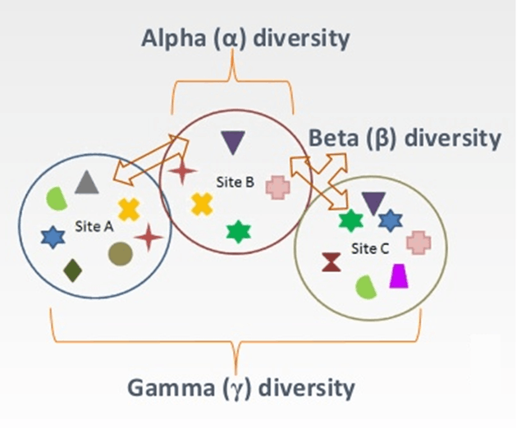
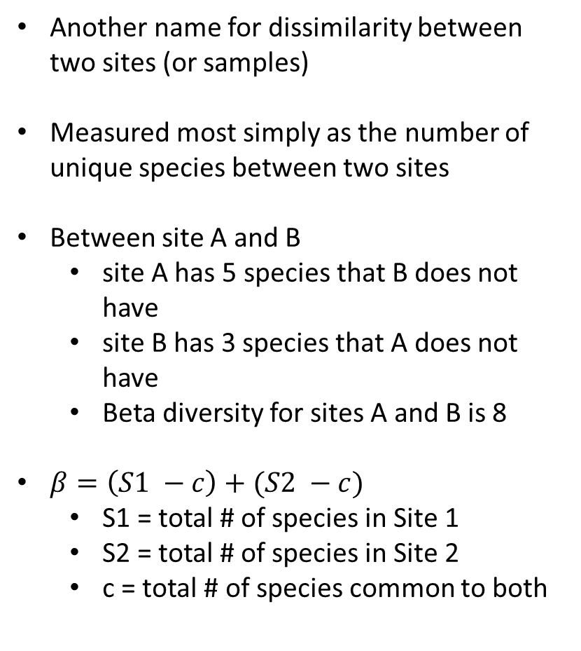
Beta Diversity
Another name for dissimilarity between two sites (or samples)
Measured most simply as the number of unique species between two sites
Between site A and B
site A has 5 species that B does not have
site B has 3 species that A does not have
Beta diversity for sites A and B is 8
$β=\left(S1 −c\right)+(S2 −c)$
S1 = total # of species in Site 1
S2 = total # of species in Site 2
c = total # of species common to both

Slide 27
Beta Diversity
Many similarity and dissimilarity metrics exist to calculate beta
Common indices
Bray-Curtis
Jaccard index
Aitchison distance
Sorenson similarity
Each emphasizes different aspects

Slide 28
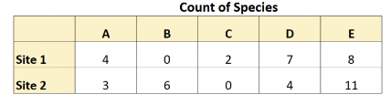
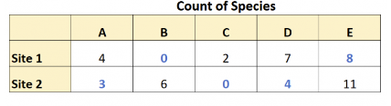
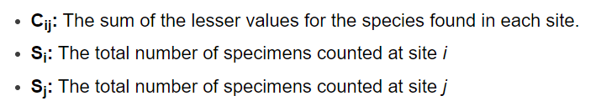
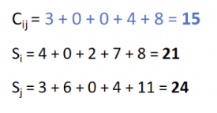
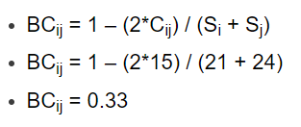
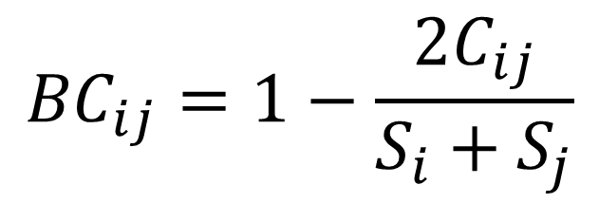
Bray-Curtis Dissimilarity
$${BC}_{ij}=1−\frac{2C_{ij}}{S_{i}+S_{j}}$$
Always ranges between 0 and 1
0 indicates that two sites share the exact same number of species
1 indicates that the two sites are completely dissimilar
Notes:
Why is beta diversity important? One reason is that two communities may have equal indices of species richness but they may be composed of totally different species.
We need analyses which are able to compare the communities as wholes, which would also mean using all available information including species identity, not only quantity and abundance.

Slide 29
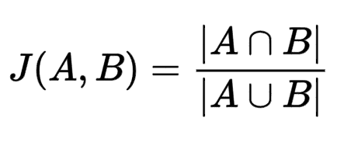
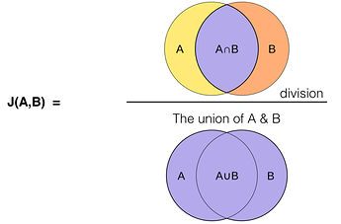
Jaccard Index
Jaccard is the percent of taxa not shared by two samples (A+B/union in the diagram below)
Does not take into account abundances, only presence and absences
Notes:
Use vegan tutorial – Bray Curtis
Jaccard: ignores exact abundances and considers only presence/absence values

Slide 30
Beta Diversity – (dis)similarity
How is this calculated when there are a lot of sites?
Generate a (dis)similarity matrix that contains for each site (rows) the dissimilarity to every other site (columns)
To understand these complex pairwise relationships, we reduce the dimensionality
So instead of a 100x100 matrix if we have 100 sites (→ 100 dimensions), we collapse this to two dimensions and use ordination techniques to visualize site similarity
There are also many different ordination techniques

Slide 31
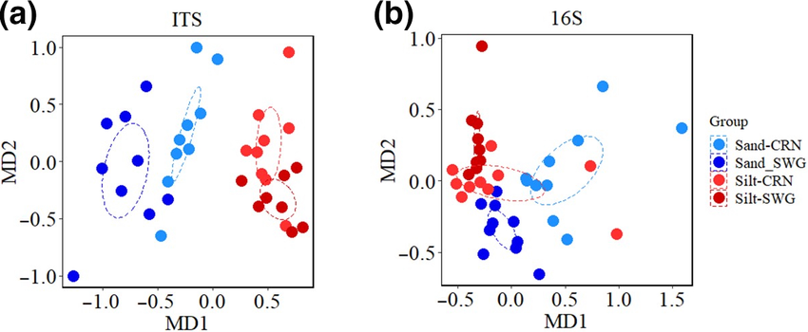
Beta Diversity
Kasanke et al. 2020

Slide 32
Individual Practice
No more manual calculations, it’s time for R!
Measuring Biodiversity Tutorial.R

Slide 33
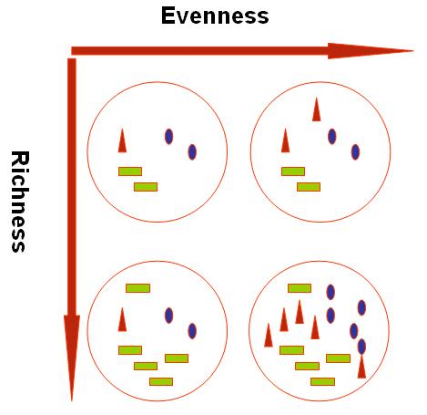
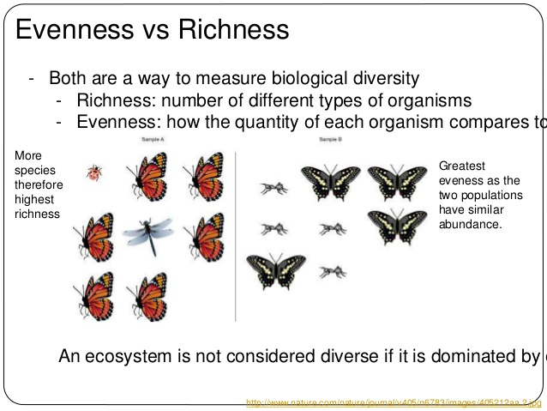
Evenness v. Richness
Notes:
Richness can remain constant, while evenness changes

Slide 34
